Slide 1
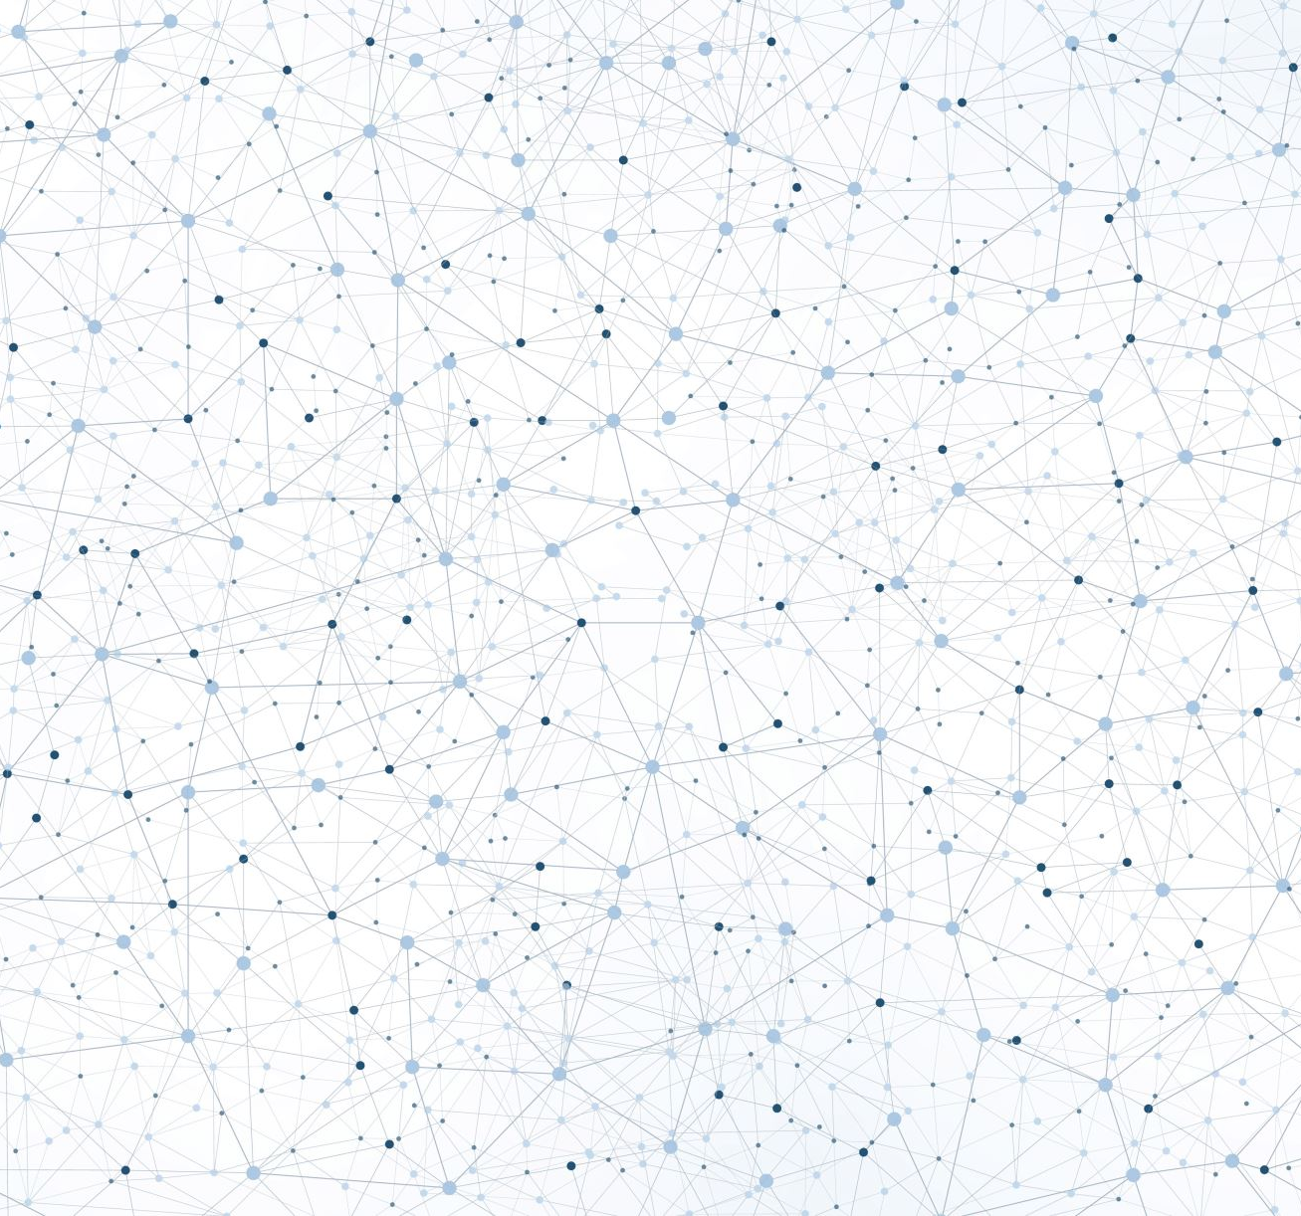
Kociemba’s Algorithm

Slide 2
Introduction
It is an improvised version of Thistlethwaite's Algorithm.
He reduced the number of intermediate groups to two.
It is a two-phase algorithm.
Average Number of Moves: 20
Maximum Moves : 29 | Minimum Moves: 19
Data Structure Required: Graph

Slide 3
Two Phase Algorithm A Brief Overview
Group | Description
Group 0 | All possible positions of the cube.
Group 1 Formula: <U,D,R2,L2,F2,B2> | Split into the top half of the cube which uses the IDA* formula to subdivide and solve
Group 2 Formula: <L2,R2,F2,B2,U2,D2> | Split into the bottom half of the cube which uses the IDA* formula to subdivide and solve
Consider all the positions of the cube as Group 0 (G0). The G0 state is dived into two phases namely Group 1 (G1) & Group 2 G(2)

Slide 4
Two Phase Algorithm Detailed Explanation – Phase 1
The algorithm looks for a sequence which will transform a scrambled cube to G1. That is, the orientations of corners and edges must be constrained, and the edges of the UD-slice must be transferred into that slice.
In this abstract space, a move just transforms a triple (x,y,z) into another triple (x',y',z'). All cubes of G1 have the same triple (x0,y0,z0) and this is the goal state of phase 1.
To find this goal state the program uses IDA* with a lower bound heuristic function.
The heuristic allows pruning while generating the sequence of moves, which is essential if you do not want to wait a very, very long time before the goal state is reached. The heuristic function h1 is a memory-based lookup table and allows pruning up to 12 moves in advance.
In the case of the Cube, this means that it iterates through all sequence of increasing length. The heuristic function h1(x,y,z) estimates for each cube state (x,y,z) the number of moves that are necessary to reach the goal state.

Slide 5
Two Phase Algorithm Detailed Explanation – Phase2
In phase 2 the algorithm restores the cube in the subgroup G1, using only moves of this subgroup.
It restores the permutation of the 8 corners, the permutation of the 8 edges of the U-face and D-face and the permutation of the 4 UD-slice edges.
The heuristic function h2(a,b,c) only estimates the number of moves that are necessary to reach the goal state, because there are too many different elements in G1.
The algorithm does not stop when a first solution is found but continues to search for shorter solutions by carrying out phase 2 from suboptimal solutions of phase 1.
E.g., if the first solution has 10 moves in phase 1 followed by 12 moves in phase 2, the second solution could have 11 moves in phase 1 and only 5 moves in phase 2. The length of the phase 1 maneuvers increase and the length of the phase 2 maneuvers decrease. If the phase 2 length reaches zero, the solution is optimal and the algorithm stops.

Slide 6
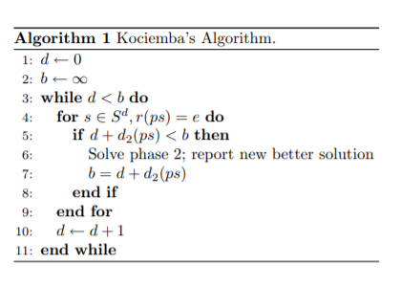
Algorithm

